Slide 1
Tuberculosis
Assist. Prof. Dr. Hussein ALNaji

Slide 2
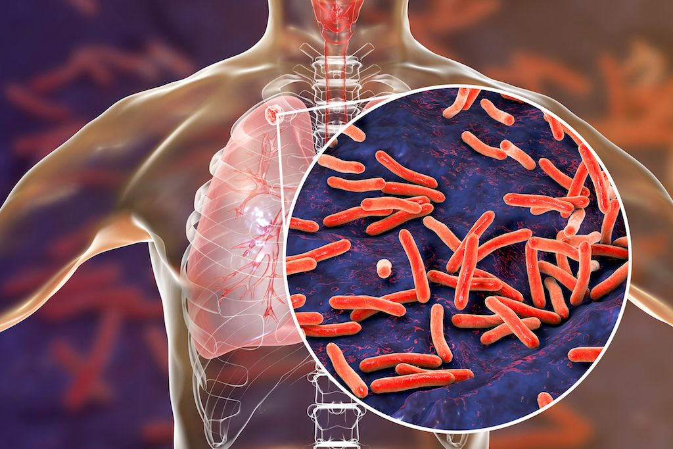
Tuberculosis is an infectious disease that can cause infection in your lungs or other tissues. It commonly affects your lungs, but it can also affect other organs like your spine, brain or kidneys. The word “tuberculosis” comes from a Latin word for "nodule" or something that sticks out.
Tuberculosis is also known as TB
TB is caused by the bacterium Mycobacterium tuberculosis. The germs are spread through the air and usually infect the lungs, but can also infect other parts of the body.

Slide 3
Everyone infected with TB bacteria (germs) becomes sick. So, there are two types of TB conditions:
1- Latent TB infection, where the TB germs live in your body but don't make you sick.
2- TB disease (active TB) where you get sick from the TB germs.
TB disease can almost always be cured with antibiotics. But if it's not treated properly, it can be fatal.
In addition to active or inactive, found different kinds of TB, including the most common, pulmonary (lung) tuberculosis and extrapulmonary TB (TB outside the lung) such as, Meningitis, Sterile pyuria mean high levels of white blood cells in your urine, Pott’s disease also called spinal tuberculosis or tuberculosis spondylitis. Addison’s disease occur in adrenal gland. Hepatitis, Lymphadenitis in neck, also called scrofula or TB lymphadenitis.

Slide 4
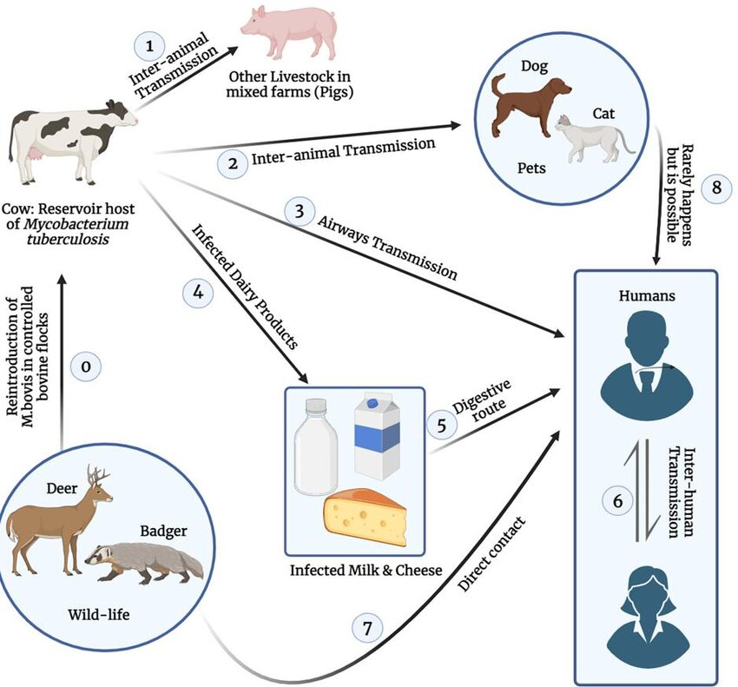
Transmission
1- The germs spread from person to person through the air.
2- People who have TB disease in their throat or lungs spread the germs in the air when they cough, sneeze, talk, or sing.
3- Anyone who is near a person with TB disease can get infected with the germs.

Slide 5
Symptoms
With TB disease, your symptoms will depend on where the TB is growing in your body:
General symptoms may include:
1- Chills and fever
2- Night sweats (heavy sweating during sleep)
3- Losing weight without trying
4- Loss of appetite
5- Weakness or fatigue
Symptoms from TB disease in your lungs may include:
1- A cough that lasts longer than 3 weeks
2- Coughing up blood or sputum (a thick mucus from the lungs)
3- Chest pain

Slide 6
Diagnosis
1- Screening test
There are two kinds of screening tests for TB: the Mantoux tuberculin skin test (TST) and the blood test, called the interferon gamma release assay (IGRA).
For the TST, a healthcare provider will inject a small amount of a substance called purified protein derivative (PPD) under the skin of your forearm.
For the IGRA, a healthcare provider will draw blood and send the sample to the lab.
2- Lab tests on sputum and lung fluid.
3-Chest X-ray.
4- Computed tomography (CT) scans.

Slide 7
Prevention
1- Washing your hands thoroughly and often.
2- Coughing into your elbow or covering your mouth when you cough.
3- Avoiding close contact with other people.
4- Making sure you take all of your medication correctly.
5- Not returning to work or school until you’ve been cleared by your healthcare provider.

Slide 8
Thank you

